Slide 1
Senior Capstone
Software Issue & Change Management
Requirements Document
Donald Akujobi
Raymond Lemon
Wayne State University

Slide 2
Topics
Software Requirements
Concept Attributes
Domain Model

Slide 3
Responsibilities
Responsibility Description | Type | Concept Name
Rs1. Access to any part of the system, has the ability to add and remove accounts | D | Admin User
Rs2. Has Read –Only access in the System | NPU | Non-Privileged User
Rs3. Has Read & Write Access in the System | PU | Privileged User
Rs4. Read, Write, Update, and Delete information from the user | D | Database

Slide 4
Use Case 1: Unlock
Use Case UC-7: |  |  | Add A New Revision
Related Requirements: |  |  | UC1, UC3, UC5, UC9 and UC11
Initiating Actor: |  |  | Admin and Privileged User
Actor’s Goal: |  |  | To add a new report in the system that has a name, ID, and section for comments
Participating Actors: |  |  | Repository
Preconditions: |  |  | • There must be a name of the system • There must be a ID of the report
Postconditions: |  |  | The report is added with a corresponding ID to the system
Flow of Events for Main Success Scenario:
→ | 1. | Admin or Privileged User
 | 2. | include::Authenticate User (UC-7)
← | 3. | There must be a name and ID of report
← | 4. | The report is added correctly in the system

Slide 5
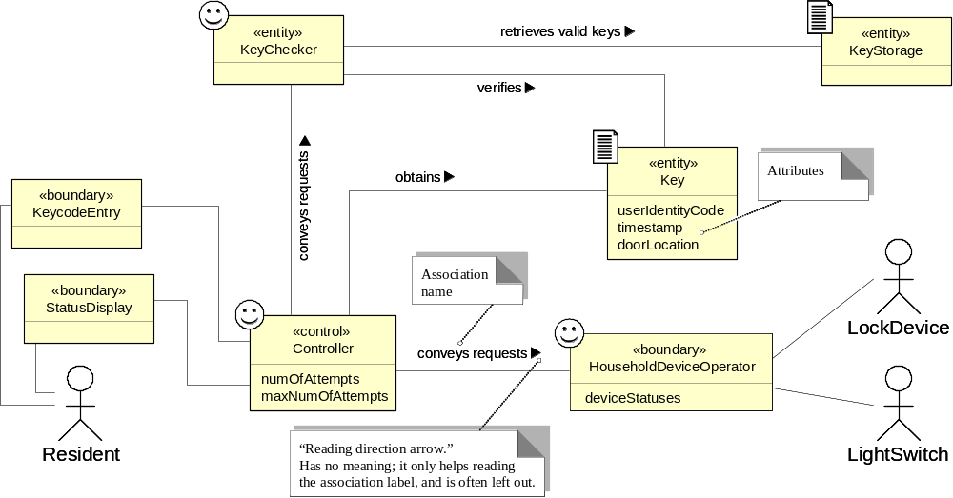
Domain Model (7a)
Domain model for UC-7: Add A New Revision
Associations: who needs to work together, not how they work together
Concept pair | Association description | Association name

Slide 6
Use Case UC-8: |  |  | Show Revision
Related Requirements: |  |  | UC2,UC4, UC6, UC10 and UC12
Initiating Actor: |  |  | Admin, Privileged or Non Privileged User
Actor’s Goal: |  |  | View the Revision Report
Participating Actors: |  |  | Repository
Preconditions: |  |  | • There must be a name of the system • There must be a ID of the report
Postconditions: |  |  | The report is shown in the screen with the correct information
Flow of Events for Main Success Scenario:
→ | 1. | Admin, Privileged or Non Privileged User
 | 2. | include::AuthenticateUser (UC-8)
← | 3. | There must be a name and ID of report
← | 4. | The report and correct information is shown in the screen
Use Case 1: Unlock

Slide 7
Use Case UC-9: |  |  | Add A New Target File
Related Requirements: |  |  | UC1, UC3, UC5, UC7 and UC11
Initiating Actor: |  |  | Admin or Privileged User
Actor’s Goal: |  |  | Add A New Target File
Participating Actors: |  |  | Repository
Preconditions: |  |  | • There must be a name of the system • There must be a release name • There must be a report ID • There must be a File Path • There must be a Revision Status • There must be a Change Type
Postconditions: |  |  | A correct Target File is added
Flow of Events for Main Success Scenario:
→ | 1. | Admin, Privileged or Non Privileged User
 | 2. | include::AuthenticateUser (UC9)
← | 3. | There must be name of the system, release name, report ID, File Path, Revision Status, and Change Type
← | 4. | The Target File is properly added in the system

Slide 8
Use Case UC-10: |  |  | Show A New Target File
Related Requirements: |  |  | UC2, UC4, UC6, UC8 and UC12
Initiating Actor: |  |  | Admin, Privileged User or Non Privileged User
Actor’s Goal: |  |  | Show A new Target File
Participating Actors: |  |  | Repository
Preconditions: |  |  | • There must be a name of the system • There must be a release name • There must be a report ID • There must be a File Path • There must be a Revision Status • There must be a Change Type
Postconditions: |  |  | A correct Target File is shown in the Screen
Flow of Events for Main Success Scenario:
→ | 1. | Admin, Privileged or Non Privileged User
 | 2. | include::AuthenticateUser (UC9)
← | 3. | There must be name of the system, release name, report ID, File Path, Revision Status, and Change Type
← | 4. | The Target File is properly Shown in the Screen

Slide 9
Use Case UC-11: |  |  | Add A New Target File (Change Manager)
Related Requirements: |  |  | UC1, UC3, UC5, UC7 and UC11
Initiating Actor: |  |  | Admin or Privileged User
Actor’s Goal: |  |  | Add A New Target File (Change Manager)
Participating Actors: |  |  | Repository
Preconditions: |  |  | • There must be a name of the system • There must be a release name • There must be a report ID • There must be a File Path • There must be a Granularity Type • There must be a Change Type
Postconditions: |  |  | A correct Target File is added
Flow of Events for Main Success Scenario:
→ | 1. | Admin, Privileged or Non Privileged User
 | 2. | include::AuthenticateUser (UC9)
← | 3. | There must be name of the system, release name, report ID, File Path, Revision Status, and Change Type
← | 4. | The Target File is properly added in the system

Slide 10
Use Case UC-12: |  |  | Show A New Target File (Change Manager)
Related Requirements: |  |  | UC2, UC4, UC6, UC8 and UC10
Initiating Actor: |  |  | Admin, Privileged User, or Non Privileged User
Actor’s Goal: |  |  | Show A New Target File (Change Manager)
Participating Actors: |  |  | Repository
Preconditions: |  |  | • There must be a name of the system • There must be a release name • There must be a report ID • There must be a File Path • There must be a Granularity Type • There must be a Change Type
Postconditions: |  |  | A correct Target File is Shown
Flow of Events for Main Success Scenario:
→ | 1. | Admin, Privileged or Non Privileged User
 | 2. | include::AuthenticateUser (UC9)
← | 3. | There must be name of the system, release name, report ID, File Path, Revision Status, and Change Type
← | 4. | The Target File is properly Shown in the system

Slide 11
Use Case UC-14: |  |  | Remove A User
Related Requirements: |  |  | UC 13
Initiating Actor: |  |  | Admin
Actor’s Goal: |  |  | Delete a User
Participating Actors: |  |  | Repository
Preconditions: |  |  | The User must exist in the system
Postconditions: |  |  | User Deleted
Flow of Events for Main Success Scenario:
→ | 1. | Admin
 | 2. | include::AuthenticateUser (UC9)
← | 3. | There must be a user
← | 4. | User Deleted

